Slide 1

General Chemical Laboratory Safety
Illinois Institute of Technology

Slide 2
Chemical Laboratory Safety
This training presentation has been created for people who are required to undergo general laboratory safety training according to Illinois Institute of Technology procedures and OSHA regulations, and have not taken this training with their supervisor. This training is also recommended for any laboratory staff who need an overview of lab safety.

Slide 3
Introduction
Laboratory safety is the key to reducing injury and illness. There are many laboratory exposures that pose a health hazard. Some are things that you may have never considered a hazard before. It is important to have proper training so you, as the student or employee, are aware of the potential dangers that may threaten your health or life.

Slide 4
Introduction
As you go through this training module, you will have a better understanding regarding the concept of safety and how safety is utilized in every aspect of your life. IIT has an obligation to protect each student, assistant, faculty and staff. There are also regulations that pertain to IIT to ensure compliance.
Lets take a look at the different agencies that are involved!

Slide 5
Agency Information
Several agencies are involved in safety compliance at IIT. The following agencies impact our laboratories as far as safety is involved:
Occupational Safety and Health Administration (OSHA)
OSHA primarily monitors hazardous materials, hazard communication, bloodborne pathogens, and occupational exposure to hazardous chemicals in laboratories at IIT.
OSHA is in charge of monitoring work conditions and eliminating physical and health hazards at the work place.

Slide 6
Agency Information
National Institute of Occupational Safety and Health (NIOSH)
NIOSH is in charge of Recommended Exposure Limits (REL) used to develop OSHA standards
NIOSH

Slide 7

Agency Information
American Conference of Governmental Industrial Hygienists (ACGIH)
ACGIH annually develops Threshold Limit Values (TLV), Biological Exposure Indices (BEI), and 8 hour Time Weighted Averages (TWA).
These are legally enforceable.

Slide 8

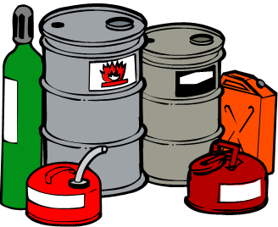
Agency Information
The EPA is in charge of the wastes that IIT generates and stores. Many hazardous wastes are used in research laboratories. They pose a threat to humans, animals, plants, and the environment.
There are also biohazardous wastes that are regulated and must be properly decontaminated and disposed of.

Slide 9

Agency Information
IIT Department of Environmental Health and Safety (EHS)
EHS plays a large role in overseeing the various activities that take place on campus.
EHS will interpret laws and regulations.
EHS will maintain up-to-date records of current health and safety standards.
The duties of EHS range from fire safety and laboratory safety to training and emergency response.

Slide 10


Supervisor
For this training module, your supervisor is either your supervisor, your professor or your principle investigator. This is the person you normally report to when working in the lab.
This is usually the person who will give you orientation on your specific lab.
If you are faculty, this would be your Department Chair.

Slide 11
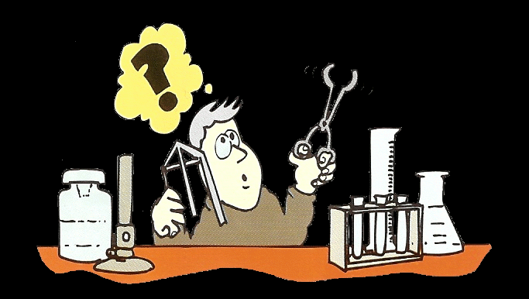
Why Training?
Training is by far the most important aspect of safety. Training not only reduces illness/injury but also increases worker efficiency and awareness.
Training is required by regulation and IIT has high regard for fulfilling this commitment.
Preventing hazards and increasing awareness is the goal for IIT.

Slide 12



Who is in charge of training?
Everyone on campus is in charge of training!
The individual is responsible for:
participation in the training,
comprehending the information,
utilizing the information for the specific duties.
The supervisor is in charge of:
providing proper and effective training,
assuring students/employees receive training.
The EHS office
provides assistance to departments in achieving regulatory compliance,
develops proactive strategies for training compliance.

Slide 13

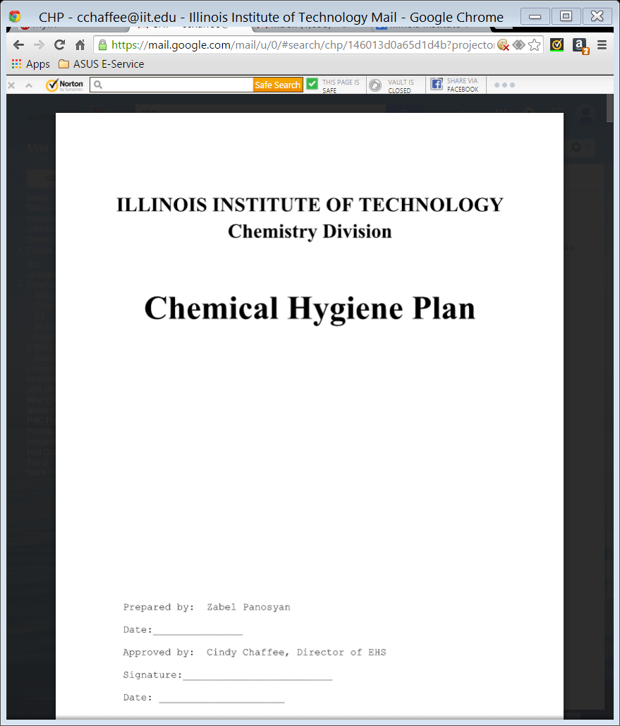
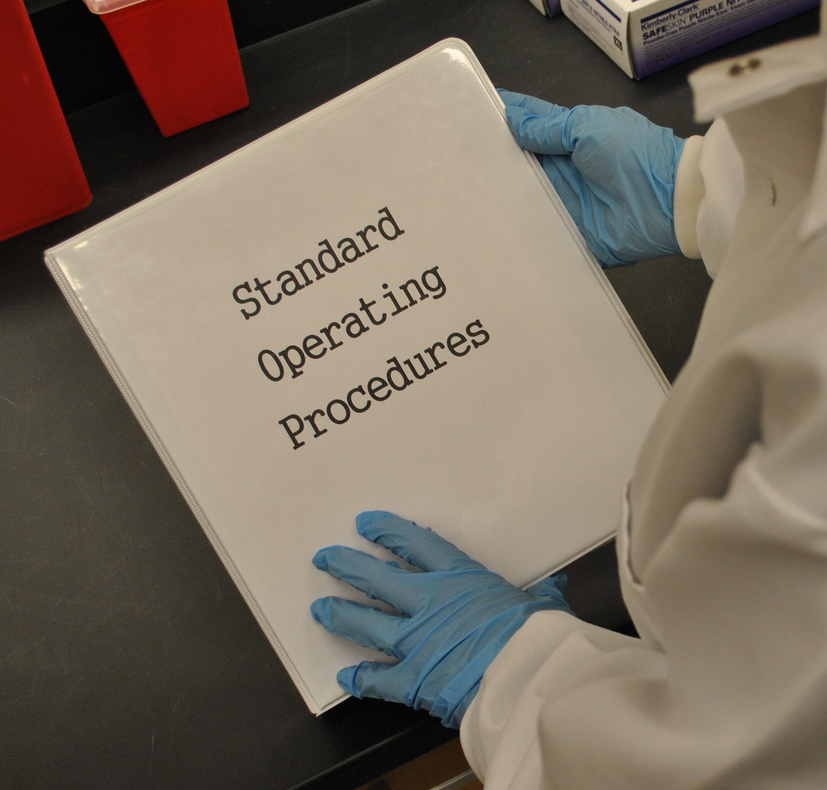

Know the Details/Location of your Vital Laboratory Information!

Slide 14


Laboratory Information
One of the most important type of communication regarding hazards is the SDS or Safety Data Sheet. The SDS will communicate the information necessary regarding hazards associated with chemicals and also biological agents. Labeling and SDS guidelines are covered in IIT GHS training.

Slide 15
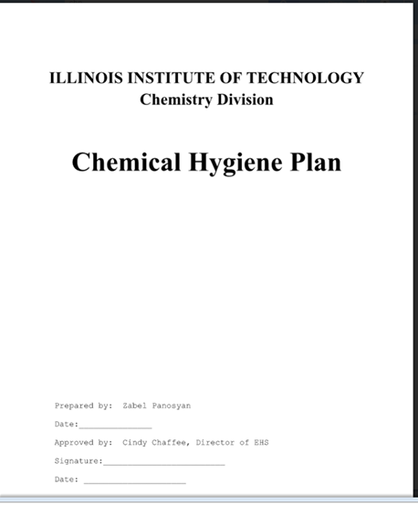
Laboratory Information
Each lab that has chemicals will have a lab specific Chemical Hygiene Plan. This plan will detail the procedures and practices for your specific location.
It is YOUR responsibility to make sure that YOU review the CHP.

Slide 16
Laboratory Information
The Chemical Hygiene Plan (CHP) is similar to the Hazard Communication Program, but this is specifically for laboratories with chemicals. This document relays information regarding procedures, equipment, personal protective equipment (PPE), and work practices that are capable of protecting occupants from health hazards.

Slide 17

Laboratory Information
Be Prepared for your work in the laboratory. Read all procedures, the CHP, and SDS thoroughly before entering the laboratory.
Each lab contains an Emergency Action Plan which is required for emergency situations. This is used to inform faculty/staff/students of the procedures to follow in the event of an emergency. The Emergency Action Plan is part of the Chemical Hygiene Plan.
Also included in or near the Chemical Hygiene Plan binder are the Standard Operating Procedures (SOP). These documents describe how your lab will handle a hazardous chemical or process safely. They include special handling procedures, engineering controls, and PPE required.

Slide 18
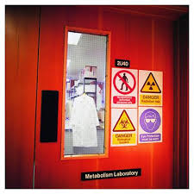

Laboratory Information
Signs
Signs are a way of communicating important information. It is a way to heighten awareness about hazards that exist.
There should also be signs on the laboratory refrigerator reminding you that no food or drink can be stored in it. A refrigerator may contain radioactive, chemical or biological materials that could possibly be absorbed in food.
There may also be signs which denote that PPE must be used.

Slide 19
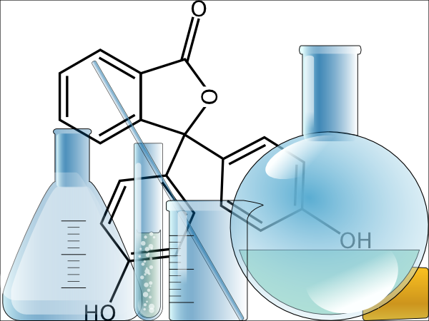
Introduction to the Laboratory

Slide 20
Let’s Get Started!
Working in a laboratory can be an exciting experience. It can also pose many threats and hazards that a traditional classroom does not. That is why it is important to know your surroundings. Know where the exits to your room are. There may be more than one exit which could be critical in the case of an emergency. Your supervisor will go over the Emergency Action Plan including the escape route procedures for your room.

Slide 21
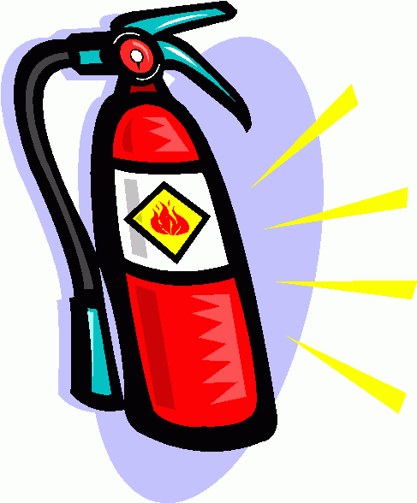
Know Your Surroundings
It is recommended occupants be aware of the fire extinguishers in location to your laboratory. In order to fight a fire one must undergo the proper training. Campus personnel are highly encouraged to not fight fires. In the event of a fire, the first response is to evacuate the area and notify the fire department! From any campus phone just dial 911. Do not wait any longer than necessary to call, time is of the essence!

Slide 22
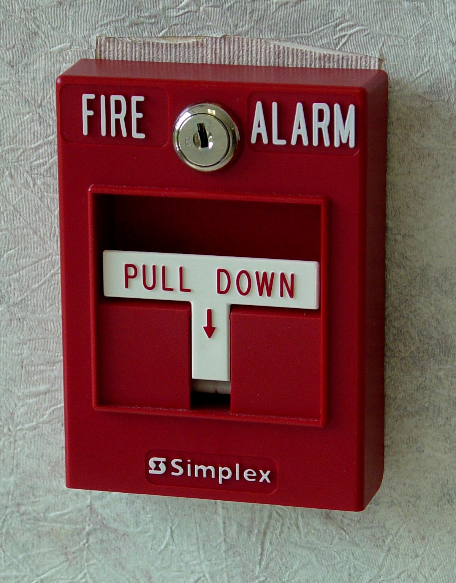
Know Your Surroundings
Know where the fire alarm is in proximity to your laboratory. Is it right down the hall or is it in the stairwell? If there is a fire, a quick response is the best response. Have your supervisor show you the closest alarm. The fire safety training during your individual lab orientation will detail the safety procedures for your specific lab.

Slide 23
Know your Surroundings
Many laboratories contain hazardous substances.
A hazardous substance is defined as a material/substance that poses a physical or health hazard. This includes both chemicals and biological agents.
A Biohazard is defined as any organism that is capable of replication and is capable of causing disease in human, animal or plant.
There are differences between a physical hazard and a health hazard. Let’s take a look.

Slide 24

Know your Surroundings
A health hazard has one or more of the following characteristics:
Carcinogen
Toxic or highly toxic
Reproductive Toxin
Irritant
Corrosive
Sensitizer
Hepatotoxic
Nephrotoxic
Neurotoxin

Slide 25

Know your Surroundings
A physical hazard has one or more of the following characteristics:
Explosive
Flammable
Pyrophoric
Organic peroxide
Compressed gas
Combustible liquid
Unstable (Reactive)
Water-reactive

Slide 26
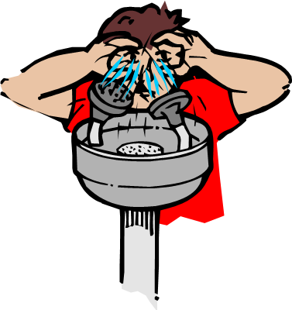

Know Your Surroundings
When physical hazards and health hazards exist, it is very important to know where the eye wash/safety shower is located. Unexpected accidents do occur and knowing where to go at the time of an emergency can reduce injury/illness.

Slide 27

Know Your Surroundings
First Aid kits have a variety of quick relief items. If your lab has a first aid kit, find out where it is. If more than first aid is needed, you shall go to Student Health Services or Mercy Center, whichever applies to your position. In an event that would require more than first aid to be treated, call 911 and report it to your supervisor as soon as possible.

Slide 28
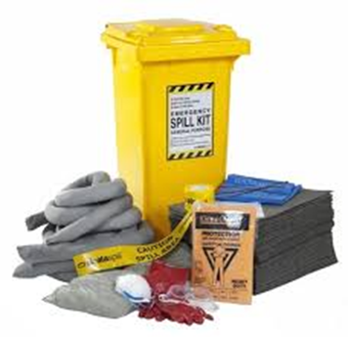
Know Your Surroundings
When there are chemical, biological, or radioactive agents being used, an emergency spill kit shall be available. Find the location of the spill kit. Further information will be addressed in IIT Chemical Spills training.

Slide 29

Know Your Surroundings
Each laboratory has a telephone in a designated area for use. The emergency contact numbers are posted near the phone in every laboratory on IIT campus.

Slide 30

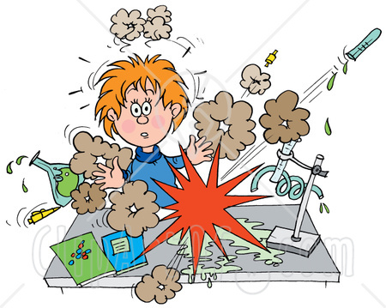
Know what Hazards are Present

Slide 31
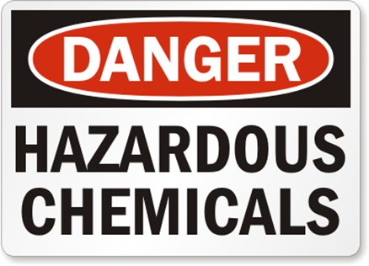
Hazards in Your Lab
Each lab is faced with different hazards. There could be exposure to biological, chemical, or radioactive material, which may pose a variety of physical and /or health hazards. This training will be primarily focusing on chemical hazards. People facing biological and /or radioactive hazards will be required to take additional training. Let’s look at chemical hazards a little closer.

Slide 32
Hazards in Your Lab
When a chemical is in the laboratory, the hazards of that chemical must be communicated to you. According to The Occupational Safety and Health Administration (OSHA), a Chemical Hygiene Plan (CHP) is required to relay information regarding procedures, equipment, Personal Protective Equipment (PPE), and work practices that are capable of protecting employees from health hazards.
Your supervisor is in charge of providing the information contained in the CHP to you.

Slide 33
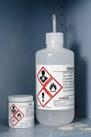
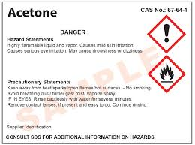
Hazards in your Lab
Labeling
It is important to know as much about a chemical as possible. The most dangerous substance is the one that has no label.
Communicating information is essential in the science field.

Slide 34
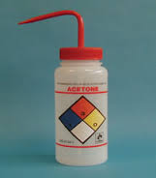
Hazards in Your Lab
Labeling is also required for chemicals that are in a secondary container.
When labeling the secondary container the following information must be included:
Identity of the hazardous chemical
Appropriate hazard warnings
Name and address of the chemical manufacturer, importer, or other responsible party.

Slide 35
Lab Safety
The following guidelines have been established to minimize the hazards in a laboratory setting. It is important to take responsibility for your actions and to keep in mind that irresponsible acts could have lasting future effects.
The next portion of training is meant to remind you of responsible conduct in a laboratory setting.
As the hazards increase, the risks increase, and the responsibility must increase.

Slide 36
Experiments
Perform only those experiments authorized by your supervisor.
Carefully follow the Chemical Hygiene Plan (CHP), the Standard Operating Procedures (SOP) and any written or oral instructions given by your supervisor.
If you do not understand a direction or part of a procedure, ASK your supervisor or a knowledgeable person before proceeding with the activity.

Slide 37


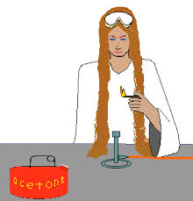
Lab Attire
You should remember the following:
Shoes must completely cover the foot. No open-toed shoes.
No shorts/skirts unless a lab coat is used.
Restrain hair when working in the lab.
Dangling jewelry and baggy clothing are a hazard in the laboratory. They must be secured.
Do not wear protective clothing outside the lab.
Use the proper Personal Protective Equipment (PPE) for the job.

Slide 38

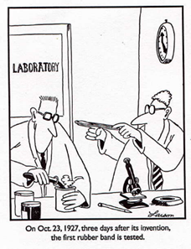
Personal Habits
Personal habits play a large role in minimizing hazards. The following measures must be taken:
Conduct yourself in a responsible manner at all times in the laboratory.
Horseplay, practical jokes, and pranks are dangerous and prohibited.
Be alert and proceed with caution at all times. Notify your supervisor of any unsafe conditions you observe.
Do not wander around the room, distract others, startle others or interfere with the laboratory experiments of others.

Slide 39

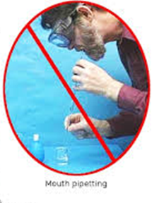

Personal Habits
Do not eat, drink, smoke, chew gum or apply cosmetics, or remove/insert contact lenses while in the laboratory.
Do not use laboratory glassware as containers for food or beverages.
Do not store food or beverages in the lab or in a chemical refrigerator.
Do not mouth pipette.
Keep hands away from face, eyes, mouth, and body while using chemicals or lab equipment.
Wash hands before leaving the laboratory, after handling contaminated material and after performing all experiments.

Slide 40

Safe Practices
These safe practices should be followed to ensure safe working conditions:
When working with hazardous materials, have a second person nearby.
Know emergency procedures before you start.
Observe good housekeeping practices. Keep the laboratory neat and clean at all times.

Slide 41
Equipment
If you do not understand how to use a piece of equipment, ask a qualified person for help.
Do not operate a hot plate by yourself.
Take care that hair, clothing and hands are a safe distance from the hot plate at all times.
Never look into a container that is being heated.

Slide 42

Safe Practices
Take only as much chemicals as you need.
Never return unused chemicals to their original container.
Use hazardous chemicals under a fume hood and biohazardous materials under a biosafety cabinet (BSC).
All procedures should be performed to minimize aerosol.
Decontaminate as needed.
Never remove chemicals or other materials from the laboratory area.

Slide 43

Chemical Hygiene

Slide 44

Chemical Hygiene
Protection against chemicals is a combination of work procedures or practices, emergency procedures, and personal protective equipment (PPE). Some chemicals can only be handled under certain conditions. It is important to use proper handling procedures and practices as advised. The emergency procedures for chemical accidents is first evacuate the area and then notify your supervisor, IIT Public Safety and the EHS office if necessary.

Slide 45
Chemical Hygiene
Responsible practices and techniques are required when working with hazardous materials. This is one very important way to reduce accidents/injuries. Practices and techniques should be implemented through following the CHP, the Standard operating Procedures (SOP) for the lab, the SDS for the chemical, directions from your supervisor and the IIT Safety Procedures.

Slide 46
Chemical Hygiene
Methods and observations used to detect the presence or release of chemicals will be specific to your lab. A good indication of the presence of a chemical is to rely on your senses. Can you see it or smell it? Is a monitoring device needed to detect it? This can be important information if the chemical is an asphyxiant and pushes oxygen out of the room you are in.
When using your senses do it in a safe manner. For instance, when it is necessary to smell chemicals in the lab, the proper technique is to cup your hand above the container and waft the air toward your face. This will reduce the risk of damaging your mucous membranes or your lungs. Never put your nose right above or in the container.
Ask your supervisor to demonstrate the proper way to sense the chemicals that you will be using.

Slide 47
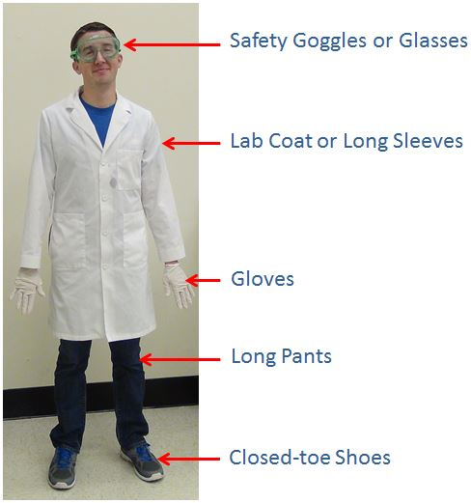
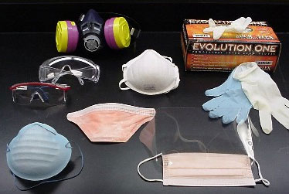
Personal Protective Equipment (PPE)

Slide 48
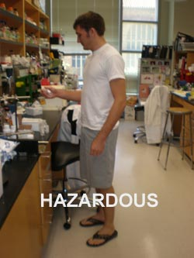
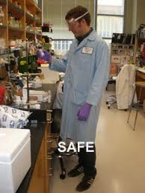
Personal Protective Equipment
Knowing What to use and when to use it is the key to properly protecting yourself. There could be situations that would be more of a risk and require more PPE than others. The next few slides will help you in determining what you should be using!

Slide 49
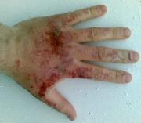


Personal Protective Equipment
Chemical usage poses a variety of hazards. They can be flammable, corrosive, even toxic just to name a few. Taking all precautions to avoid physical and/or health problems is the number one goal. You can never be too cautious!

Slide 50
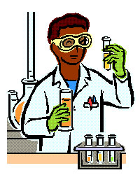
Personal Protective Equipment
When chemicals are being used there is always the possibility of splashing. The proper PPE to use when chemicals are involved would include but are not limited to:
Safety Glasses/Goggles
Lab Coat
Gloves
Respirator - Use depending on the chemical and the exposure duration. The Permissible Exposure Limit (PEL) for an 8 hr. shift can be obtained from the PEL/BEL reference guide. Contact EHS if questions arise.

Slide 51
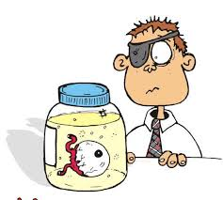
Personal Protective Equipment
Knowing how to properly use PPE can be the key to adequate protection. Not only do you want to make sure it is the proper size for you, but also make sure you are wearing it properly.
If it is too big or too small, it is not right for you! Let your supervisor know if you need a different size.
If you wear your safety glasses on top of your head instead of over your eyes, they will not protect your eyesight.

Slide 52
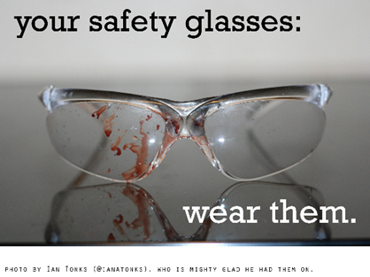
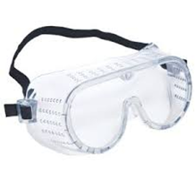
Personal Protective Equipment
Safety Glasses or Goggles
Any time chemicals, heat or glassware are used, safety glasses/goggles are required.
Everyone in the laboratory, including visitors must wear chemical splash goggles or chemical safety glasses at all times, even when not performing a chemical or glassware operation.

Slide 53
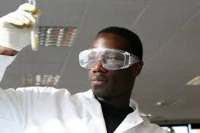
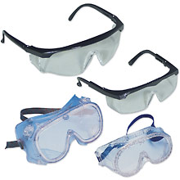
Personal Protective Equipment
Safety Glasses or Goggles
All chemical, biological and engineering labs at IIT require that safety glasses or goggles be donned before entering the room.
There are no exceptions to this rule!!!

Slide 54
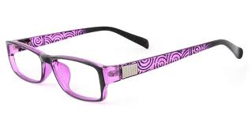

Personal Protective Equipment
Normal prescription eyeglasses do not provide appropriate laboratory eye protection. Although some prescription glasses may meet the U.S. Food and Drug Administration standards for impact resistance, never rely on such eyeglasses for protection in the laboratory.

Slide 55
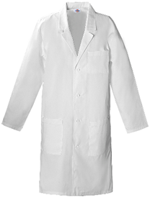
Personal Protective Equipment
Lab Coat: A lab coat or smock should be worn during laboratory experiments. Lab coats protect the skin and clothing from splatter and spills.
Appropriate lab coats should be fully buttoned with sleeves rolled down.
They should also be fire-resistant.
In case of an accident, it is much faster and easier to remove a lab coat than street clothes to minimize skin contact with hazardous materials.
Keeping your lab coat in the lab prevents spreading contamination from the laboratory to your home.

Slide 56
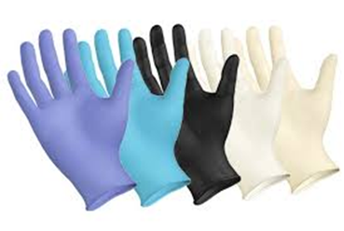
Personal Protective Equipment
Gloves: It is important to wear gloves when working with hazardous chemicals and other materials because they protect our hands from infection and contamination. Protective gloves should be selected on the basis of the hazards involved.
Nitrile gloves protect against most chemicals and infectious agents.
Rubber gloves protect against mild corrosive material.
Neoprene gloves protect against most solvents, oils, and mild corrosive materials.
Avoid latex gloves as many people are allergic or develop allergies to this material.
Cloth or leather gloves may protect against hot or cold objects but they will not protect against hazardous chemicals.

Slide 57
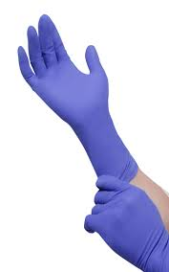
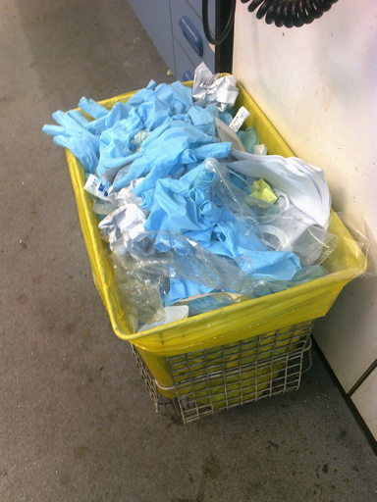
Personal Protective Equipment
Gloves: Use gloves correctly. Always check your gloves before each use to ensure the absence of cracks and small holes. Be aware that no glove material can provide permanent protection. Eventually liquids will permeate the glove.
DO NOT reuse disposable gloves because chemicals cannot be totally removed and they may have physical damage.
Dispose of them in the designated hazardous waste container as directed by your supervisor.

Slide 58
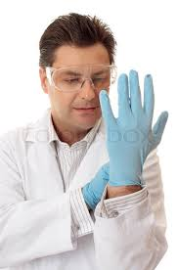
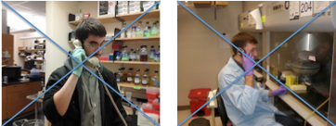
Personal Protective Equipment
When to Wear Gloves
Wear gloves when your hands may come into contact with:
Infectious materials
Radioactive materials
Chemicals
When Not to Wear Gloves
Don’t wear gloves when touching common surfaces, such as telephones, computers, door knobs, and elevator buttons, or surfaces that may be touched without gloves by others.
Don’t wear gloves outside of the lab. When transporting hazardous materials between labs, use secondary containers that can be carried without gloves. (Bring gloves and spill materials in case of an accident.)

Slide 59
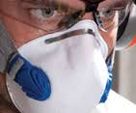
Personal Protective Equipment
The piece of equipment that is crucial to use appropriately is the respirator. If a respirator is required, you will be part of the IIT Respiratory Protection Program. This requires a physical administered by a medical professional, a fit-test, and additional training before use. If the respirator does not properly fit to you, serious health problems can result.

Slide 60
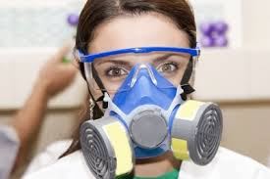
Personal Protective Equipment
If you think you need a respirator talk with your supervisor to start the process.

Slide 61
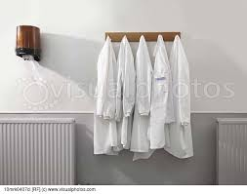

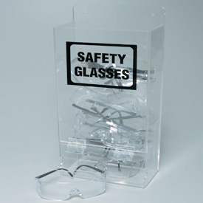
Personal Protective Equipment
Each lab should have a designated storage area for the PPE that is used. The PPE should also be readily available when working with materials that require it.
If the proper equipment is not available, you should not proceed with the work. Notify your supervisor when you need to order PPE. Give advanced notice when possible due to shipping time. Always consider in advance what you will need when conducting research.

Slide 62

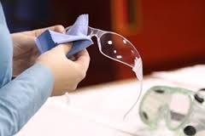
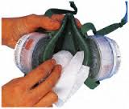
Personal Protective Equipment
In order to be able to rely on your equipment, you must take care of it.
Keep PPE clean and disinfected. It should be cleaned before and after use when possible.
Proper maintenance can not only extend the life of the equipment, but also keep cost down. Keeping the cost down on the Personal Protective Equipment can help to better allocate the money toward larger equipment needed for research.

Slide 63

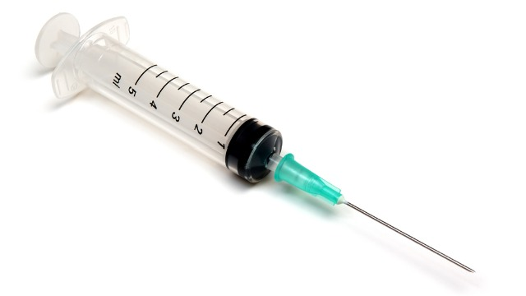
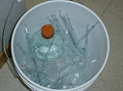
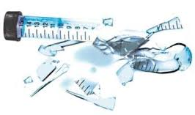
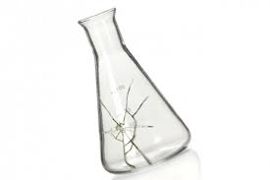
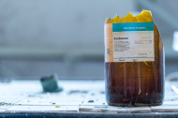
What is a Sharp?

Slide 64
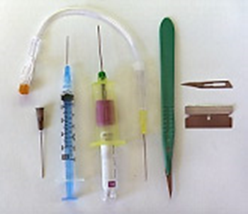
Sharps
A sharp is defined as any instrument, tool, or item that has rigid, acute edges, protuberances or corners capable of cutting, piercing, ripping or puncturing such as syringes, blades and broken glass. Items that have the potential for shattering or breaking are also considered sharps.

Slide 65
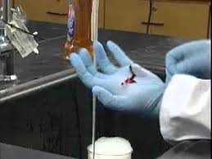

Sharps
When using a sharp there is a risk of being cut by the object and possible infection occurring depending on what the sharp was used for.
If hypodermic needles are used, special precautions must be taken to reduce the risk of a needlestick. After use of the needle DO NOT RECAP, place the needle directly in the sharp container

Slide 66




Sharps Disposal
A sharps disposal container must meet the following standards:
Rigid
Non breakable and puncture resistant
Impervious to moisture and leak proof
Have a self-closing lid
Labeled “sharps only” and “No infectious syringes” unless it is specifically for that purpose.

Slide 67

Sharps Disposal
Biohazardous/infectious sharps, including syringes, needles, and blades that are not contaminated with chemicals or radioactive materials, must be placed in a red container labeled sharps with a biohazard symbol and the word biohazard.
Non-contaminated serological pipettes and pipette tips can be discarded in a sharps box for broken glass.

Slide 68

Sharps Disposal
Sharps containers MUST NOT:
Be filled greater than 2/3 full.
Be discarded in the regular trash unless they are not contaminated.
Contain free liquids, such as full culture tubes or filled syringes.
Sharps containers MUST BE:
Stored where waste is generated.
Segregated from other waste.

Slide 69

Sharps Disposal
Who ya gonna call?
When the sharps container is 2/3 full it must be collected:
Sharps contaminated with chemical waste – Call EHS at (312) 567-3084
Sharps contaminated with biohazardous/infectious material – Call you supervisor
Non-contaminated sharps such as broken glass, razor blades, etc… - Create a Facilities Work Request Order using FAMIS
Sharps contaminated with radiation – Call the radiation safety officer at (847) 965-1999

Slide 70

Sharps Disposal
If it Don’t look good!
If an injury occurs as a result of a sharps accident, it must be recorded with an accident investigation form. This form is available on-line through the IIT web site. The main purpose of the form is for risk assessment and documentation. This will help others avoid repeating the same type of injury.
If a sharps injury involves an infectious agent, a hazardous chemical, radioactive material or anything beyond first aid, it is advised to seek medical attention immediately.

Slide 71




Safety Equipment

Slide 72
Safety Equipment
Certain equipment is necessary to achieve compliance and most importantly to provide adequate protection.
The safety equipment that is needed is known as primary and secondary barriers. Lets take a look at the difference in the barriers.

Slide 73
Safety Equipment
Primary barriers are referring to protective measures including engineering controls. This includes not only PPE that has already been covered in this course, but it also includes safety cabinets, fume hoods, vaccines and autoclaves.
It is important to know when this equipment is to be used and how to properly use it.

Slide 74
Safety Equipment
The fume hood is one of the primary barriers. It is used with chemicals. The main function is to exhaust the vapors and gases that are generated in the hood to the outside. The hood is designed to minimize your exposure to airborne contaminants. This is not to be used with biohazardous materials. If you are required to use a fume hood further training will be provided.
People using biohazardous materials will perform the tasks in a Biosafety cabinet rated to the class that their sample requires.

Slide 75
Safety Equipment
Secondary barriers are the facility design and construction. These barriers are to provide protection for the individuals outside the lab, the community, and the environment.

Slide 76
Safety Equipment
An example of a secondary barrier would be a laboratory. It is separate from the classroom and has limited access.
The animal room has limited access and is only available to authorized personnel.
The autoclave is set away from normal traffic.
The hand washing facilities are located within the lab and not accessible by the outside students.

Slide 77






Spills

Slide 78

Spills
Spills and accidents can pose a serious health and safety threat. When a spill occurs, an aerosol can be created which can make the material several times more potent. The best measure to take in order to protect yourself is to be prepared. There should be standard operating procedures (SOP) for this type of situation in your lab.

Slide 79


Spills
Being able to recognize the hazards, mitigate the spill, and notifying response authorities can be your best defense.
The first response to a spill should be:
to evacuate the immediate area until the scope of the hazard has been addressed.
Seek medical attention if necessary.
Allow sufficient time for the aerosol to settle before considering entering the room.
If you are responsible for clean up, proper training shall be provided.

Slide 80


Spills
Report to your supervisor all spills.
If medical attention is needed, call emergency services at 911 or public safety at (312) 808-6363.

Slide 81





Waste Management

Slide 82
Waste Management
Hazardous, radiological and biohazardous waste has special guidelines for proper disposal. It is important to properly dispose of waste to ensure human and environmental health. The EPA regulates the waste that is generated at IIT.

Slide 83





Waste Management
Contaminated Waste can be classified as either hazardous, radioactive or biohazardous.
Hazardous Waste – this is a waste which contains the characteristics of being any of the following:
Toxic
Corrosive
Explosive
Flammable
Oxidizer

Slide 84
Waste Management
Dispose of all waste properly
Never put chemicals into a sink or down the drain unless the substances are allowed by local regulations to be put into a sanitary sewer system. For example, water and dilute aqueous solutions of sodium chloride, sugar and soap may be disposed of in the sink.
Put ordinary waste paper in a wastepaper basket separate from chemical wastes. If a piece of paper is contaminated, such as paper toweling used to clean up a spill, put the contaminated paper in the special container that is marked for this use. Such paper must be treated as chemical waste.
Broken glass belongs in its own marked waste container. Broken thermometers may contain mercury in the fragments; they belong in their own labeled container.

Slide 85
Waste Management
Waste Pickup
For hazardous waste contact EHS at (312) 567-3084.
For biohazardous waste contact your supervisor.
For radioactive waste contact the RSO at (847) 965-1999.

Slide 86

Congratulations!!!
You have now completed the General Lab Safety Training presentation.
If you have any questions please take the time to ask your supervisor or call EHS. Remember, this is a university--questions are always welcome and encouraged.
Once you pass the quiz, you have completed General Laboratory Safety Training.
Thank you to ISU for the training information.

